Slide 1


Recommendation Systems: Connecting Customers to Products
Recommender systems use data to predict user preferences and suggest relevant products, improving customer experience and driving sales.
by Nikith Ainapuri

Slide 2

What is a Recommender System?
1
Personalized Recommendations
2
Improving Customer Experience
Recommender systems use data to personalize product suggestions for each individual user.
Personalized recommendations enhance customer satisfaction by presenting relevant items that align with their interests.
3
Driving Sales
Effective recommendations increase product visibility and encourage users to purchase more.

Slide 3
Key Components of Recommendation Engines
Data Collection
Model Training
Recommendation Generation
Gathering information about users, products, and their interactions is crucial for building accurate recommendations.
Algorithms are trained on collected data to learn patterns and predict user preferences.
The trained model generates recommendations based on user data and product attributes.

Slide 4


Collaborative Filtering: Leveraging User Interactions
Based on user-item interactions
Identifying similar users or products
Recommending items liked by similar users
Example: "Users who liked this product also liked..."

Slide 5




Content-Based Filtering: Analyzing Product Attributes
Analyzing Product Features
Identifying keywords, descriptions, and attributes that characterize products.
User Profile Creation
Building a profile of user preferences based on their past interactions with similar products.
Matching Products to Profile
Recommending products that match the user's profile and interests.

Slide 6

Hybrid Approaches: Combining Techniques
Improved Accuracy
Overcoming Limitations
Combining different recommendation techniques enhances the accuracy and diversity of suggestions.
Hybrid approaches address the shortcomings of individual techniques, providing more robust recommendations.
Enhanced Personalization
Utilizing multiple sources of information leads to a more personalized experience for users.

Slide 7





Recommendation Systems in E-Commerce
Personalized Product Suggestions
Product Discovery
Introducing users to new and relevant products they might not have found otherwise.
Recommending products based on browsing history, purchase history, and user preferences.
Boosting Sales
Improving Customer Satisfaction
Increasing product visibility and encouraging users to purchase more.
Providing a more personalized and enjoyable shopping experience.

Slide 8
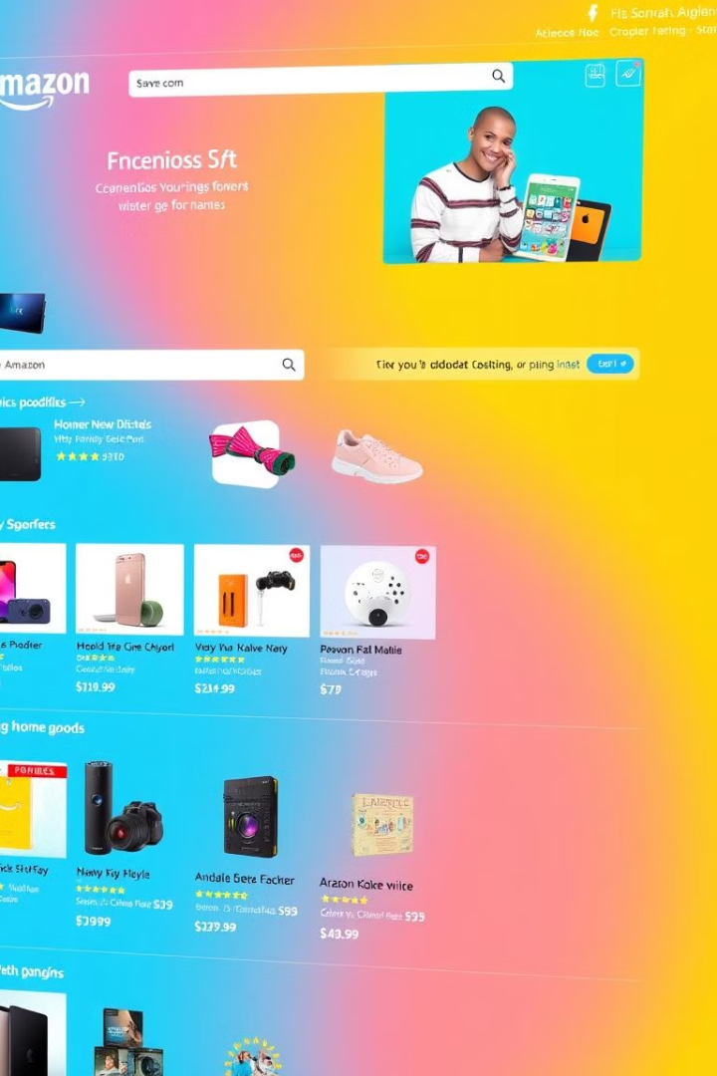
Example: Amazon's Product Recommendation Engine
1
Data Collection
Amazon gathers data from user browsing, purchase history, product ratings, and search queries.
2
Algorithm Training
Algorithms are trained on vast amounts of data to learn patterns and predict user preferences.
3
Recommendation Generation
Personalized recommendations are displayed on the website, influencing customer decisions.

Slide 9

Conclusion: The Future of Personalized Recommendations
Recommendation systems will continue to evolve with advancements in AI and machine learning, delivering even more personalized and insightful recommendations.

